Slide 1
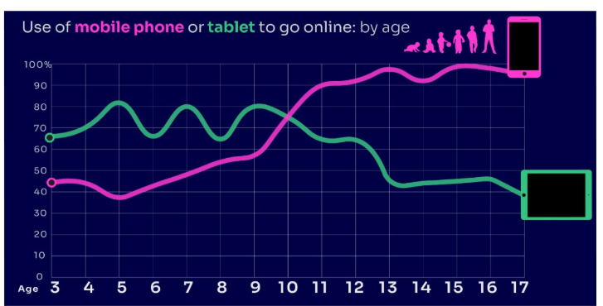
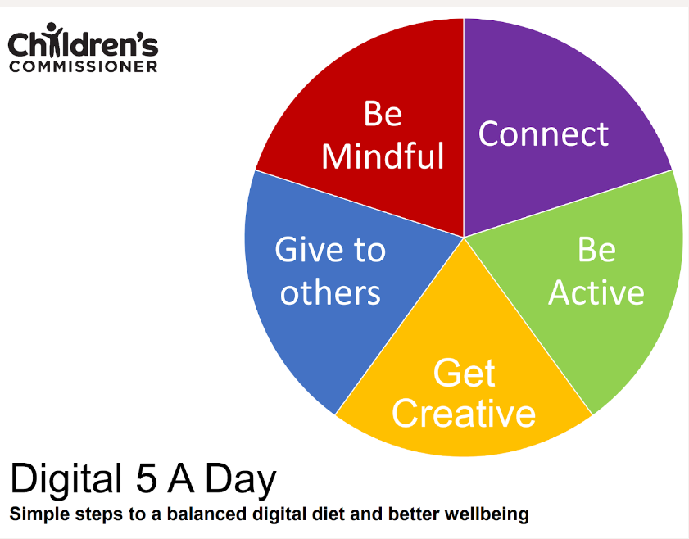
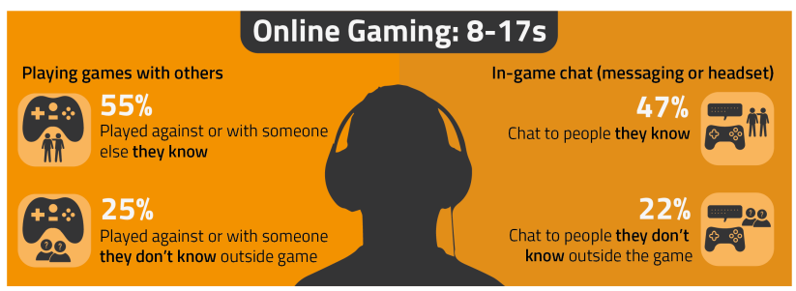
PARENT ONLINE SAFETY
A ready to use Presentation for Schools, Community Groups and Youth Centres
Notes:
This presentation brings together:
- the latest research and key findings on children’s and young people’s online use and risk
- parents’ views about their children’s media use, devices and supervision to monitor or limit use
- suggested resources and tips to empower parents to keep up with the latest trends/apps and games, manage controls and settings, and talk to children about risk - from bullying and sharing content, to extremism and gangs

Slide 2
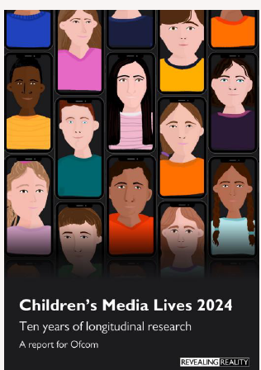
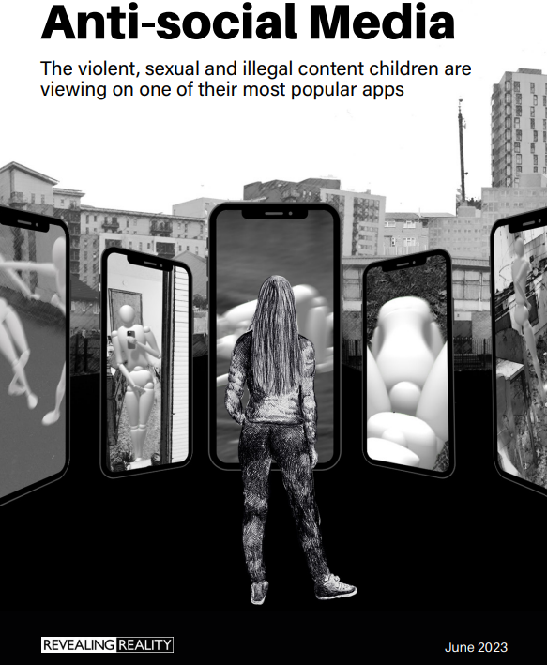
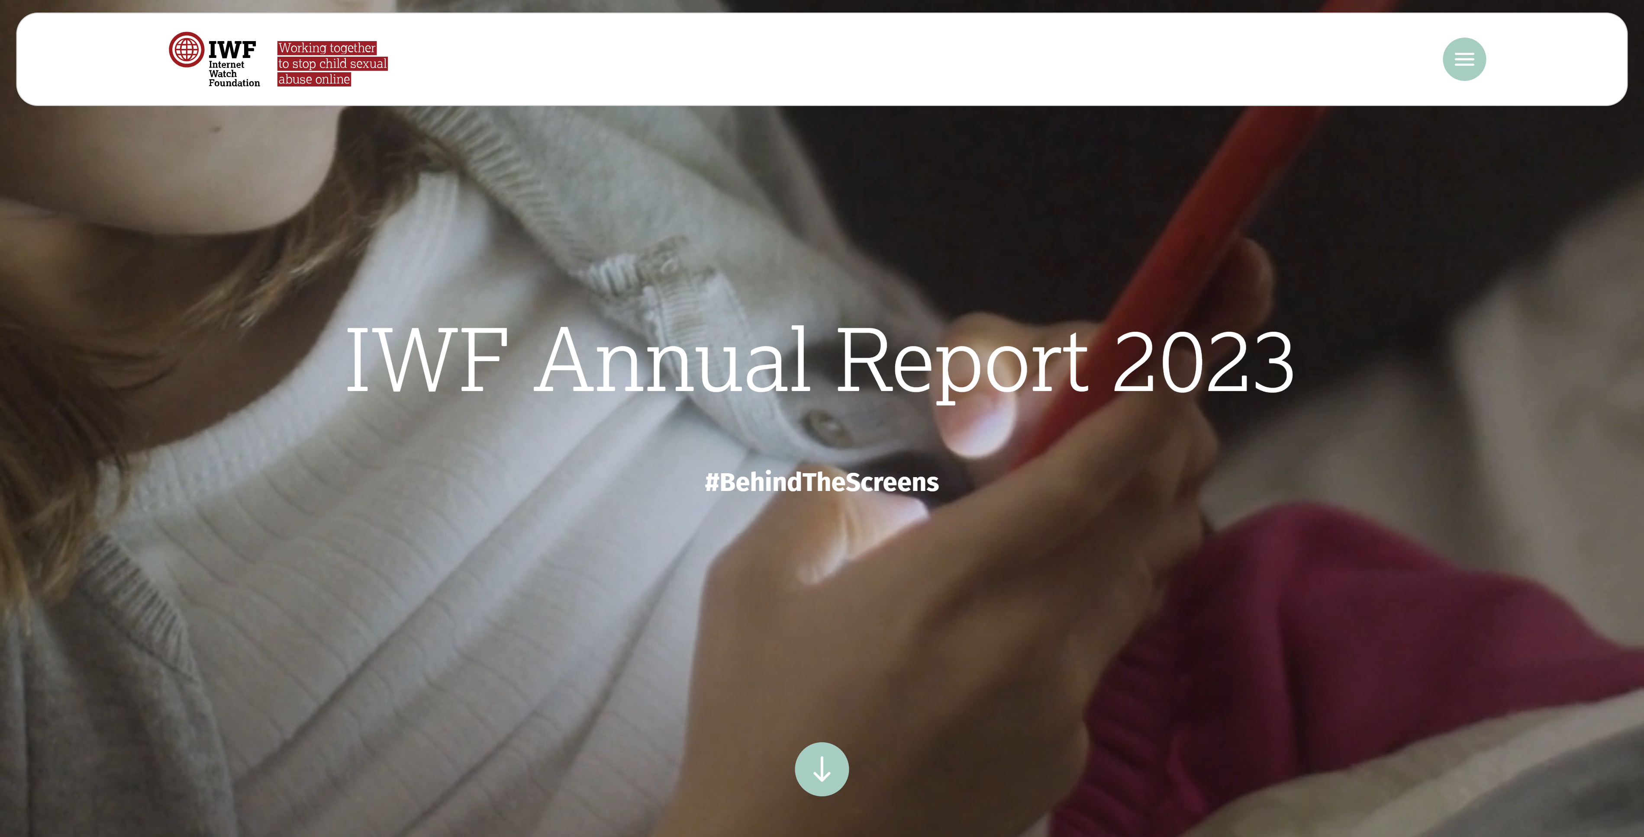
This presentation brings together:
Key Findings from:
Children and parents: Media Use and Attitudes report
Children’s Online User Ages 2023 Quantitative Research Study
Children’s Media Lives: Year 10 findings – 19 April 2024
Revealing-Reality Anti-social Media Report 2023
Internet Watch Foundation Annual Report 2023
Evidence on pornography’s influence on harmful sexual behaviour among children Report 2023
Suggested Resources and Tips for Staff to help Parents/Carers:
keep up with the latest trends, apps and games
manage controls and settings
talk to children about risk

Slide 3
Warning! Some of the content from this presentation may be sensitive or upsetting for parents/carers
Notes:
Some of the content from this presentation may be sensitive or upsetting for parents/carers. You may wish to use/adapt this slide as a trigger warning, depending on the topic(s) you cover, e.g. online sexual abuse.

Slide 4
TALKING TO YOUR CHILD ABOUT LIFE ONLINE

Slide 5
What are you most WORRIED about when your child is ONLINE?
Notes:
ASK: Find out what parents are currently worried about
TELL: Despite the positive finding that over seven in ten (72%) 8-17-year-olds who use messaging/social media sites or apps feel safe when using these apps/online sites, either all or most of the time, the online space is a risky environment for children.

Slide 6
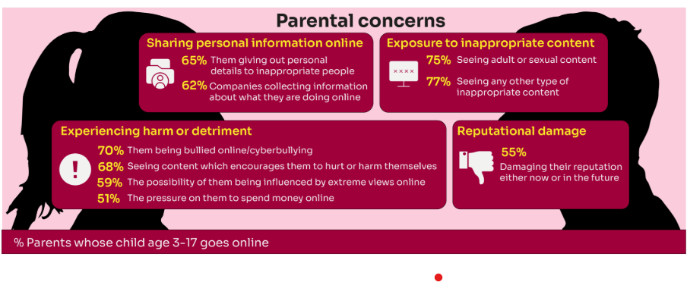
Summary of parental concerns (3 – 17 yr-olds)
Source: Children and parents: media use and attitudes report 2024
Notes:
Many parents indicate that they have concerns around various aspects of their children’s online activities.
The primary concern among parents of 3-17s is that their child will be exposed to inappropriate content for their age group (77% of parents were either very or fairly concerned about this aspect of their child’s online use) or see adult/sexual content (75% of parents).
Another common concern among these parents is that their child will experience some sort of harm or detriment while online; for example, seven in ten parents are concerned that their child will be bullied online (70%) or will see content which encourages them to hurt or harm themselves (68%).
Three in five (59%) parents are concerned that there is a possibility of their child being influenced by extreme views online.
Half (51%) worry about the pressure on their child to spend money online.
More than three in five parents are also concerned about their children giving away their personal data. Sixty-five percent are worried about the personal details the child themself may give out to inappropriate people, as well as 62% of parents who worry about companies collecting information about what their child is doing online.
Finally, over half (55%) of parents said they were concerned about their child’s online use and how it might damage their reputation, either now or in the future.

Slide 7
YOU don’t need to be an EXPERT … be a PARENT
It’s your choice - Don’t let others dictate when the right time is to use tech.
Stay involved – make time to communicate, talk about what they are doing. What do they enjoy? What makes them laugh?
Don’t quiz them – have regular conversations. What's their favourite app? What is the best site to learn new things from?
Join in - watch them play a game and join in. Who are they playing with? Do they know the other players?
‘Show me how…’ – ask their advice to help you with your privacy settings, who you should add as a friend, are there any risks?
Lead by example - children learn as much from watching as they do from being told not to do something, so model good behaviour
Reassure them - tell them that they won't get in trouble and that you are always there to help.
Notes:
ASK – What do you do that works well? Share good practice
REMIND - You do not need to be a tech expert to help your child with staying safe online. It’s ultimately about communication and being proactive.

Slide 8
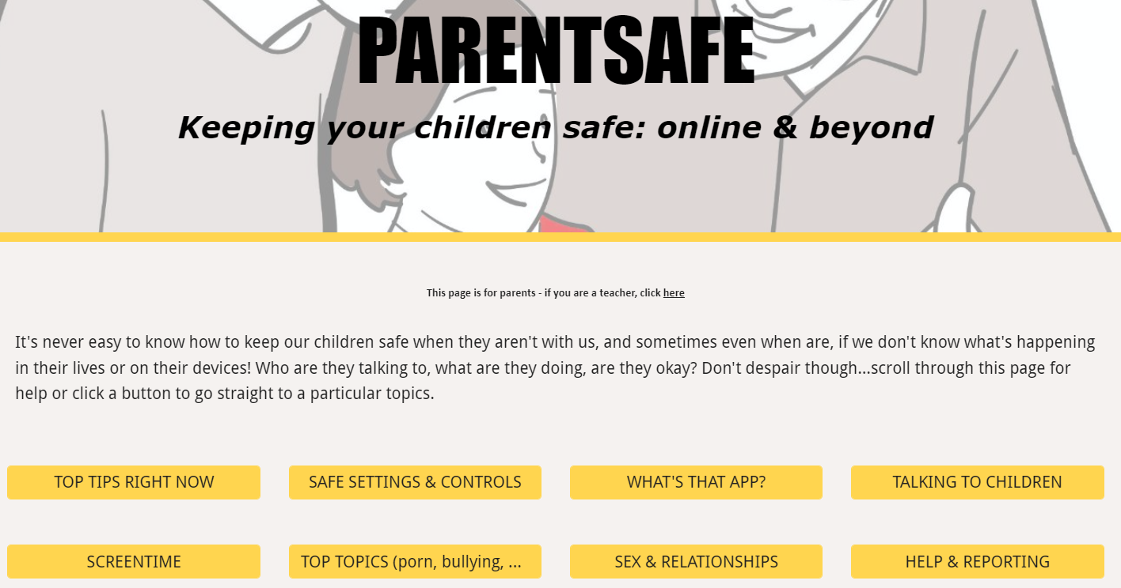
TELL - It's never easy to know how to keep our children safe, especially if we don't know what's happening in their lives or on their devices! Who are they talking to, what are they doing, are they okay? There is a dedicated website for parents and carers - simply scroll through ParentSafe for help or click a button to go straight to a particular topics
parentsafe.lgfl.net
Notes:
TELL - It's never easy to know how to keep our childrsafe, especially if we don't know what's happening in their lives or on their devices! Who are they talking to, what are they doing, are they okay? Don't despair though... We’ve created a dedicated website for parents and carers - simply scroll through ParentSafe for help or click a button to go straight to a particular topics. We will look at some of these resources and tips shortly
en

Slide 9
DEVICE USE AND OWNERSHIP

Slide 10
HOW MUCH DO YOU KNOW about your child’s life online?
Almost all children (96%) aged 3 – 17 went online in 2023, highlighting the centrality of the internet in their lives:
Younger children commonly use tablets to go online
Older children are more likely to use mobile phones
Source: Children and parents: media use and attitudes report 2024
Notes:
TELL:
We will be looking at 3–17-year-olds patterns of media use, how they access different sources of media online, and the types of online activities they are participating in. This includes their behaviours and habits in terms of viewing, playing, learning, and interacting
Almost all children from aged 5yrs (96%) went online in 2023, highlighting the centrality of the internet in children’s lives.
And we mustn’t forget that being online does create a lot of opportunity and joy for most of us. So, let’s think about how we can minimise risk and reduce their exposure to harm.

Slide 11
Does your child have their OWN MOBILE PHONE? If so, is it a SMART PHONE?
What AGE do you think is appropriate?
Source: Children and parents: media use and attitudes report 2024
Notes:
TELL - A common debate is about the age at which children should be able to use smartphones. These are mobile phones that can access the internet and have apps installed on them. Some parents have opted for non-smart’ phones, which are mobiles that usually only have text and call capabilities.

Slide 12
SMARTPHONE or ‘NON’-SMART / BRICK phone?
REMEMBER IT’S YOUR CHOICE
Every child and situation is unique,
and you are best placed to know their needs
Internet access
Social media, apps and games
Notifications
Anytime connection
Parental controls
No internet access
Some games
Anytime phone calls and texts
Limited parental controls
Notes:
ASK THEM TO CONSIDER:
How will they reduce any risks?
What does their child need the mobile for? Is it simply to stay in touch with you - then a ‘non-smart’ phone might be enough. But if you want them to access homework or learning on their mobile, then a smartphone might be better.
How you can help them child learn the basic skills to use it safely e.g. to send a message, take part in a group chat, manage their timings etc. Children need our support with developing these skills. You wouldn’t give your child a knife without guidance and support, similarly a phone can cause harm and so need to think about this.
Whatever they decide, communication is key - involve the child in the process to establish shared expectations.
Remember to set up parental control settings or use a parental controls app to help them stay safe.

Slide 13
By age 11, nine in ten children own their own mobile phone, distinct from using a family device
This correlates with transition from primary to secondary school.
Source: Children and parents: media use and attitudes report 2024
Notes:
As in previous years, the point at which it becomes more likely that a child will go online using a mobile rather than a tablet closely correlates with the age at which mobile phone ownership among children becomes almost universal.

Slide 14
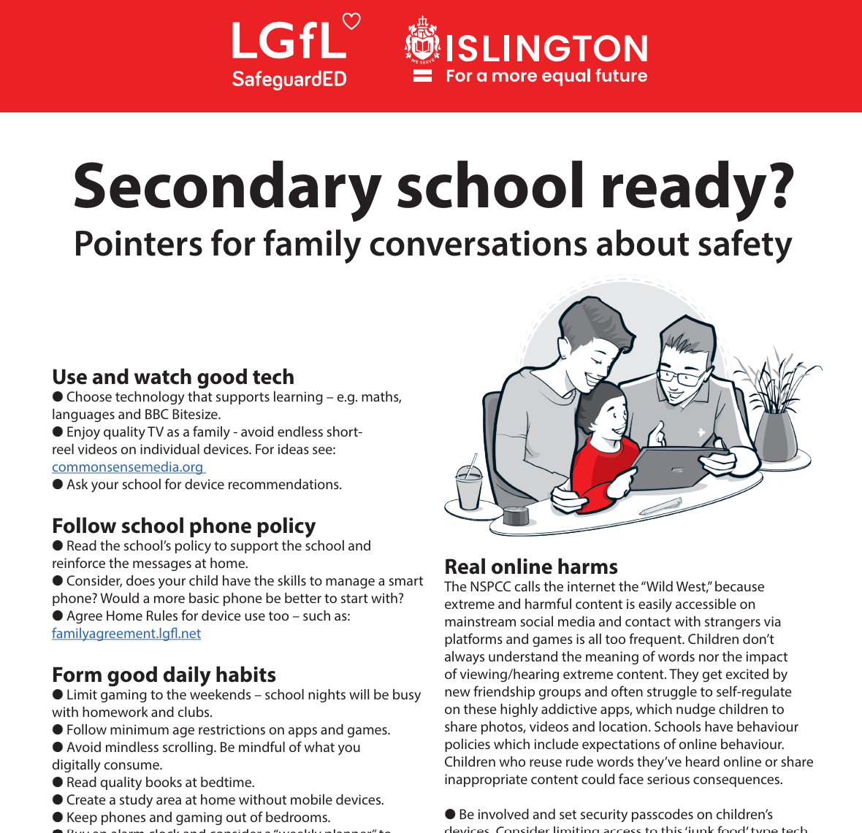
To help you with the transition of pupils from primary to secondary, why not download our FREE Leaflet for parents:
understanding risk
using tech for good
healthy habits and tips
when best to get a phone
Notes:
https://drive.google.com/uc?export=download&id=1-E_5IiDOfw3EQBPQgbGe9f2Qy3T7o_ny…
Take them through some of the key points from this leaflet on healthy habits and using tech for good

Slide 15
SUPERVISION AND PARENTAL CONTROLS

Slide 16
What RULES do YOU SET about being online?
Spending money online (52%)
Who you can interact with online
Information their child can share online (49%)
While parental concerns in some areas have increased considerably, their enforcement of rules appears to be diminishing, partly because of resignation about their ability to intervene in their children’s online lives.
Where and when devices can / can’t be used
Types of websites and apps they can use (41%)
Video content their children are allowed to watch online (67%)
Source: Children and parents: media use and attitudes report 2024
Notes:
ASK: What rules do you set for your children? How confident are you in implementing them?

Slide 17
Why not have a family agreement to:
clarify what is allowed...or not
establish ground rules like no phones at the table or in the bedroom at night-time
agree shared expectations to reduce arguments and keep everyone safe & healthy
Download it at parentsafe.lgfl.net/digital-family-agreement
Notes:
TELL:
To help facilitate this, LGfL have created a free digital family agreement that parents could sit down and populate with all family members to agree what is and is not allowed within their family around tech use. This includes parents! WE as parents also need to role model good behaviour.

Slide 18
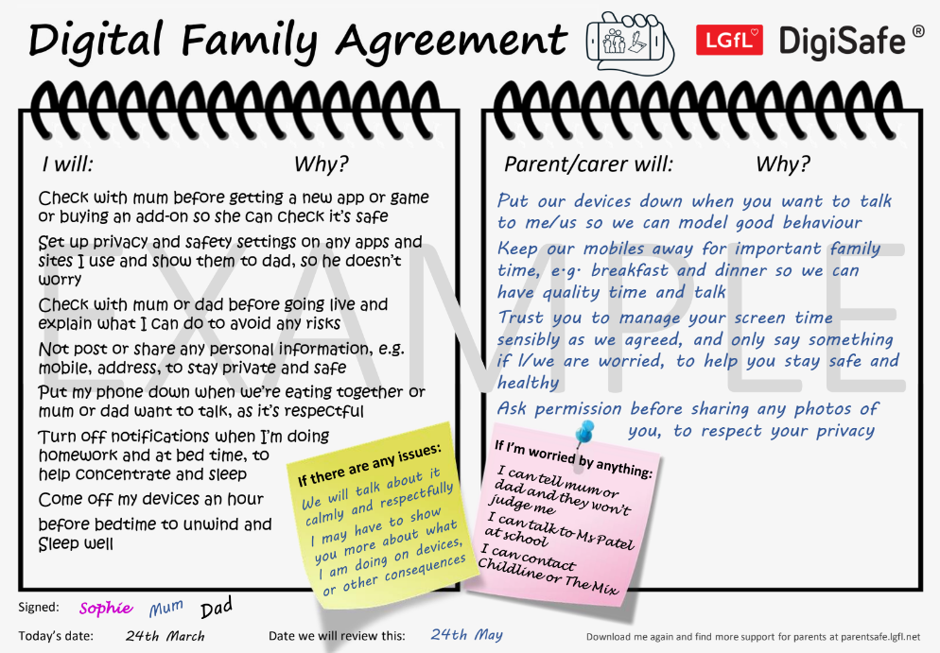
SHARENTING!
parentsafe.lgfl.net
Notes:
TELL - This is an example of a completed agreement – you may wish to take them through the sample statements to help them get started.
ASK – Have they heard of the term ‘Sharenting’?

Slide 19
What’s wrong with SHARENTING?
(when parents share photos of their children online)
Identity theft
Permanence of digital content
Losing control of images
Exposure to child predators
Creates their children’s digital footprints before they are old enough to consent to it
Notes:
TELL:
Sharenting is when parents share photos of their children online. Usually, images are shared on social media platforms to capture memorable moments in children’s lives, such as first steps, trips to the zoo, school performances, and holidays.
more than 75% of parents have shared their children’s images on social media, and 33% have never asked their children for permission before sharing photos online.
EXPLAIN THE RISKS:
Identity theft - sharenting habits expose incredible amounts of personal information about their children. More than 80% of parents use their kids’ real names on social media posts.
Permanence of digital content – even if a post is deleted, someone could have taken a copy, which could put the child at risk or lead to bullying or teasing in the future
Losing control of images - most social media sites own any content posted to their platforms. This clause is usually hidden in the terms and conditions that most users scroll through without reading. This means the platform on which it is shared has ownership of the image.
Exposure to child predators - images parents share can contain information that allows predators to track children. E.g. school or uniform, street name of the family home, while geotags can allow people with nefarious intent to track the child’s real-time location. In addition, because parents cannot control how far these photos spread, it is impossible to know where they end up, even with privacy controls in place.
Since sharenting essentially creates their children’s digital footprints before they are old enough to consent to it, the practice can also create privacy issues between children and parents that can erode trust in that relationship. For all these reasons, it is important for parents to think twice before posting about their kids.

Slide 20
Do you SUPERVISE your child’s online activity? HOW?
UNDER 12
More likely to be nearby / regularly check what their child does online
(59%)
12 - 15
Ask their child about what they are doing online
(72%)
16 - 17
Ask their child about what they are doing online
(42%)
Source: Children and parents: media use and attitudes report 2024
Notes:
TELL - The two most commonly-employed types of parental supervision among parents of 3-17s are to:
ask their child about what they are or have been doing online (59%), and
be nearby and regularly checking what their child does (55%).
Of course, this varies as the child gets older and more independent. For instance, until the child reaches the 12-15 age band, the most common method of supervision is to be nearby and regularly check what their child does. But for 12-15s and 16-17s, the most common method is to ask their child about what they are doing online (72% and 42% respectively).

Slide 21
Have you set up parental CONTROLS/PRIVACY SETTINGS for ALL DEVICES and NETWORKS?
Controls have to be set up on both the broadband connection AND each individual device
These do not come as standard so it’s worth checking
They are important because they allow you to:
Block and filter upsetting or inappropriate content or sites
Plan what time and how long your child can go online for
Notes:
TELL – it is important that these controls are set up on BOTH the broadband connection AND each individual device
About seven in ten (73%) parents of all 3-17-year-olds use at least one type of technical tool or control to manage their child’s access to online content; parents of 8-11-year-olds are more likely than those of older children to use at least one of these tools (84% vs 70% of parents of 12-15s and 54% of parents of 16-17s respectively). The most commonly-used technical tool used, across all parents of 3-17s, were parental controls built into the device by the manufacturer, e.g. Windows, Apple, Xbox, PlayStation etc. (32%). (Ofcom 2024)

Slide 22
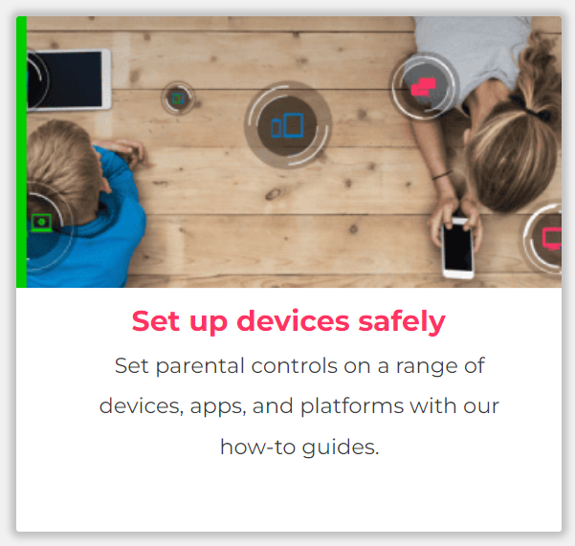
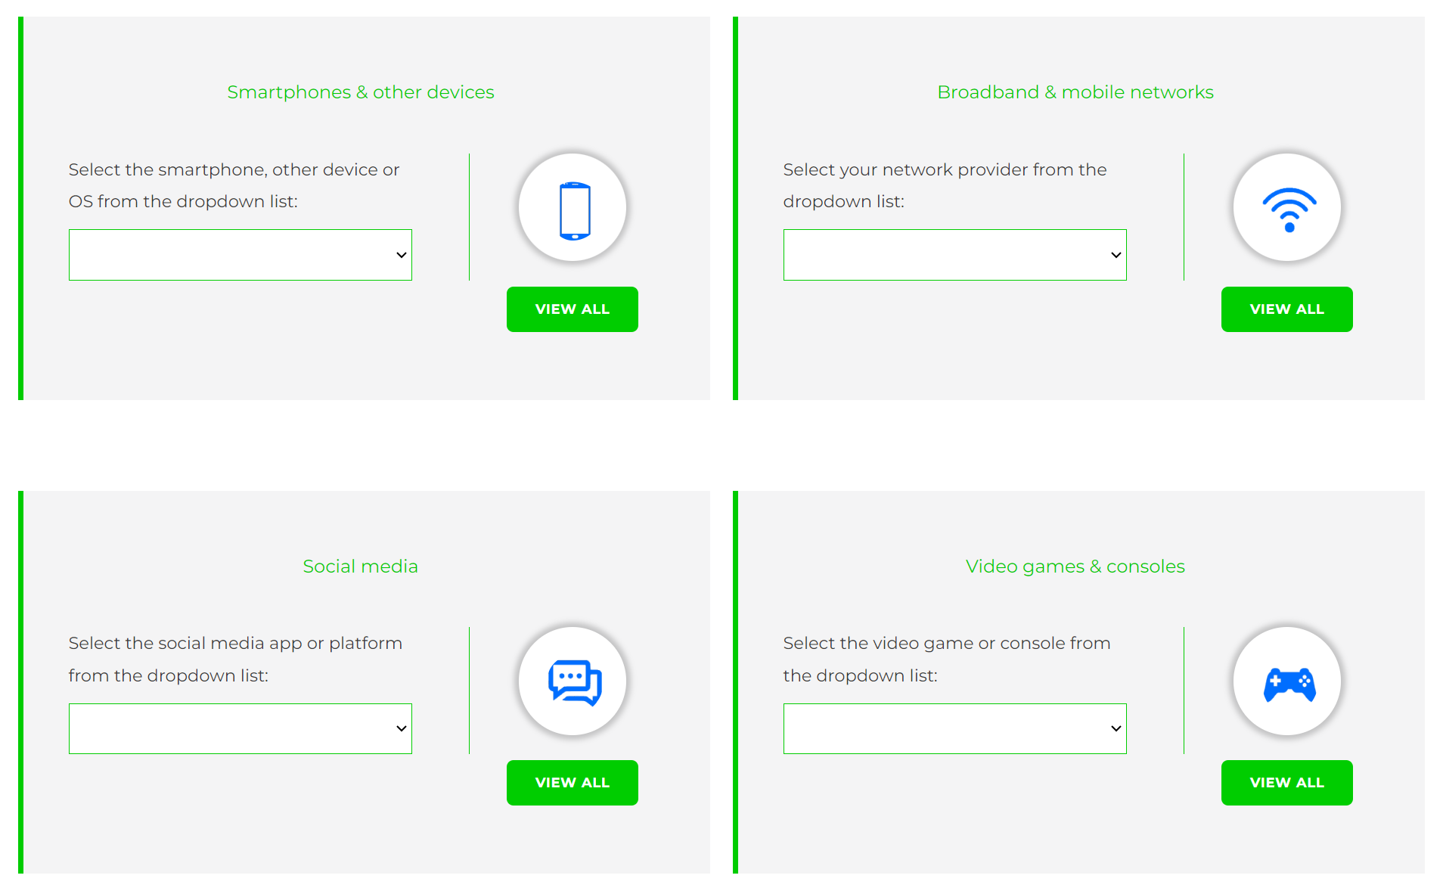
Visit www.internetmatters.org/parental-controls/ to find out how to set controls on devices:
Notes:
TELL – They can use this great page to find out how to set up controls on any smartphone, broadband, social media site/app and games console
REMIND - They need to set up parental controls on each of these individually

Slide 23
REMEMBER
As children get older, restrictions and controls you use will change, but only at a pace you feel is appropriate for your child, not pressure from your child “because everyone else is allowed”
Content filters are never 100% effective, at some point your child may come across inappropriate or upsetting content, so make time to talk regularly

Slide 24
SCREENTIME

Slide 25
WORRIED about their SCREENTIME??
Do you know HOW LONG YOUR CHILD SPENDS online daily?
Children spent an average 3 hours 5 minutes per day accessing the internet, across smartphones, tablets and computers
Four in ten (39%) parents of children aged 3-17 report finding it hard to control their child’s screentime
Visit screentime.lgfl.net for advice and tips to manage screentime
Source: Children and parents: media use and attitudes report 2024
Notes:
Parents’ concerns about their child’s screentime increases with age - Overall, four in ten (39%) parents of children aged 3-17 report finding it hard to control their child’s screentime. This increases with age, going from a third (34%) for parents of 3-4-year-olds to half (49%) of parents of 16-17-year-olds.
Threequarters (74%) of parents aged 3-4 agreed that their child had a good balance, compared to just over half of parents of older children (56% and 55% for parents of children aged 12-15 and 16-17 respectively).

Slide 26
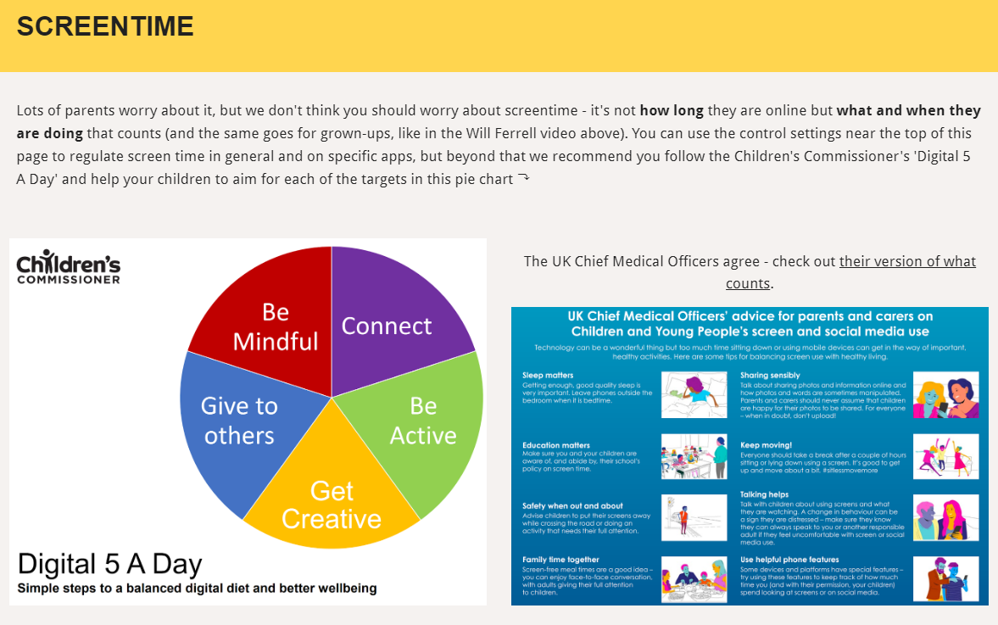
Visit parentsafe.lgfl.net/ for advice and tips to manage screentime
Notes:
ASK – Do you think lots of screentime is a bad thing generally? Why? How long is OK?
SHARE - World Health Organization (WHO) recommendations and research:
Infants (1 – 2 years) are recommended no screentime, whilst for 2 – 4-year-olds sedentary screen time should be no more than 1 hour; less is better.
When sedentary, engaging in reading and storytelling with a caregiver is encouraged
Improving physical activity, reducing sedentary screen time and ensuring quality sleep in young children will improve their physical, mental health and wellbeing, and help prevent childhood obesity and associated diseases later in life.
TELL – It’s not how long they are online but what and when they are doing that counts - take them through the UK Chief Medical Officer’s advice poster above for examples
EXPLAIN – the Digital 5 A day gives children and parents easy to follow practical steps to achieve a healthy well balanced digital diet, by encouraging them to reach of the targets in the pie chart – share some examples with them https://www.childrenscommissioner.gov.uk/digital/5-a-day/

Slide 27
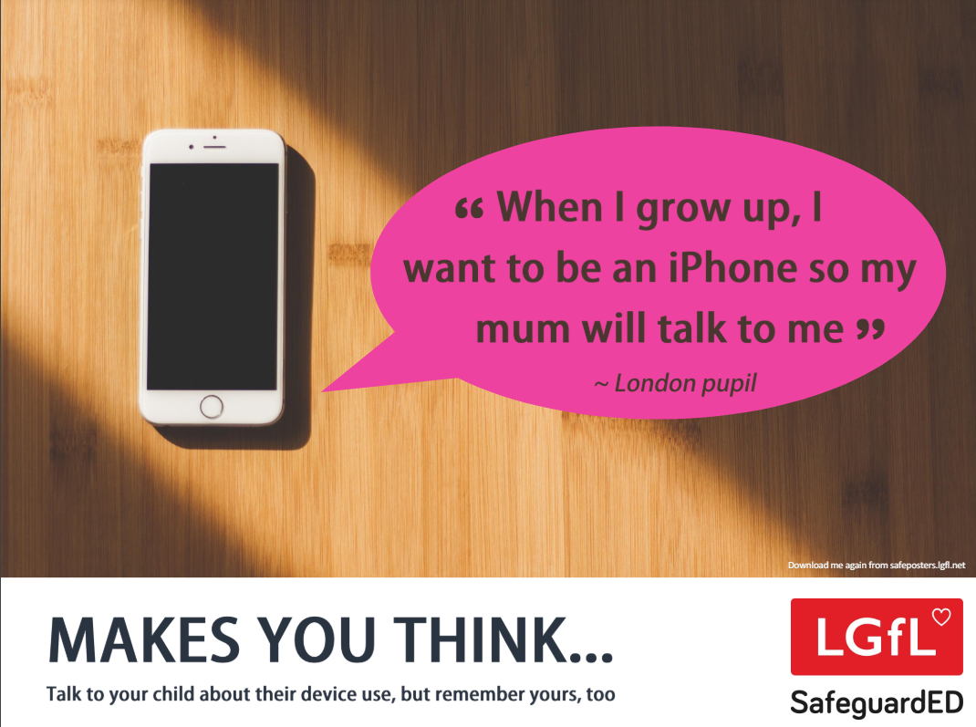
How does your child feel about YOUR SCREENTIME vs THEIRS?
45% of 8-11s feel that their parents’ screentime is too high
35% of 8-17s feel that their own screentime is too high
Source: Children and parents: media use and attitudes report 2024
Notes:
REMIND – it’s important to model good behaviour when it comes to device use, as children will follow our example. The same goes for ‘sharenting’ (see slide 22)

Slide 28
SOCIAL MEDIA AND GAMING

Slide 29
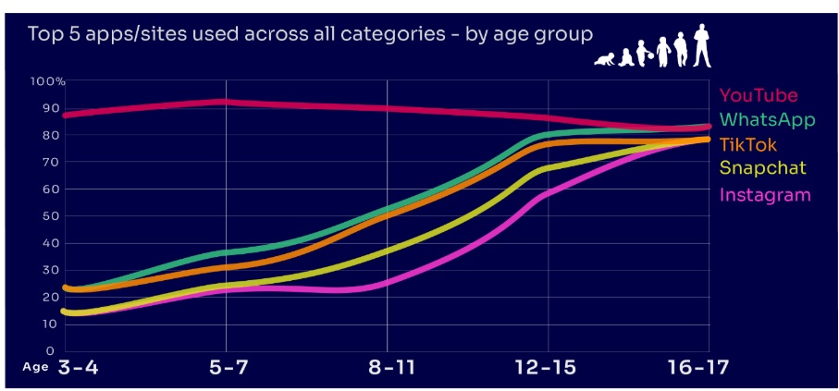
Are you FAMILIAR WITH THE APPS and GAMES your child is on?
YouTube is the most popular, but the appeal of many social media platforms varies by age
under two in ten of all 3-4-year-olds use Instagram and/or Snapchat
this rises to eight in ten among 16-17s
under a quarter of all 3-4-year-olds use WhatsApp
this rises to over eight in ten of all 16-17-year-olds
Go to apps.lgfl.net for guidance on apps and social media sites
Source: Children and parents: media use and attitudes report 2024
Notes:
YouTube is the most-used app or site among the children in our study, with more than eight in ten 3- 17-year-olds using it. However, while YouTube is a popular app across all age bands, some sites or apps grow in popularity with age. For example, just under two in ten of all 3-4-year-olds use Instagram and/or Snapchat (17% in each case) but this rises to eight in ten among 16-17s (for both apps). Similarly, just under a quarter (23%) of all 3-4-year-olds use WhatsApp, and this rises to over eight in ten (83%) of all 16-17-year-olds. This underlines the more interconnected and social nature of older children’s online behaviours; indeed, half (49%) of all 16-17-year-olds use all five of the top apps/sites (YouTube, WhatsApp, TikTok, Snapchat and Instagram).
REMIND – your children need to be 13+ to use these platforms (See slide 39)

Slide 30
What might they NOT BE TELLING YOU?
Nearly six in ten (58%) 8-17s use multiple profiles on at least one social media platform:
(23%) said it was because one account was just for parents/family to see
13% said one account was for the ‘real me’ and another contained edited/filtered posts or photos
Source: Children and parents: media use and attitudes report 2024
Notes:
TELL - This demonstrates that at least some children feel the need to present distinct aspects of themselves on social media, depending on the audience.

Slide 31
What about WHATSAPP?
Do you know the minimum age to use this?
What are the risks?
Unwanted contact | to contact somebody on WhatsApp, all you need is their phone number, which could expose you to unwanted messages or calls
Inappropriate content | messages are end-to-end encrypted which means that the content cannot be monitored. This means that your child could see or hear harmful or upsetting content e.g. pornography or violence.
Location sharing | live location feature means that your child could reveal their current location to others
Cyberbullying | children could be bullied, feel left out or deliberately excluded or removed from groups
Oversharing | privacy features, such as disappearing and ‘view once’ messages, might mean that your child feels safe to reveal private or risky information or images. However, there is always a risk that this could be copied and shared
Notes:
TELL - WhatsApp let users send messages and content to contacts added to their account. To use the service in the UK, users must be 13-years-old or older (as of April 2024. The minimum age for WhatsApp used to be 16)

Slide 32
Notes:
PLAY – ‘What's Up on WhatsApp? Group Chats and Kicking’ video showing primary pupils talking about the realities of group chats and exclusion bullying - deliberately being left out to hurt someone's feelings.
https://youtu.be/BpT8vFn6_eA

Slide 33
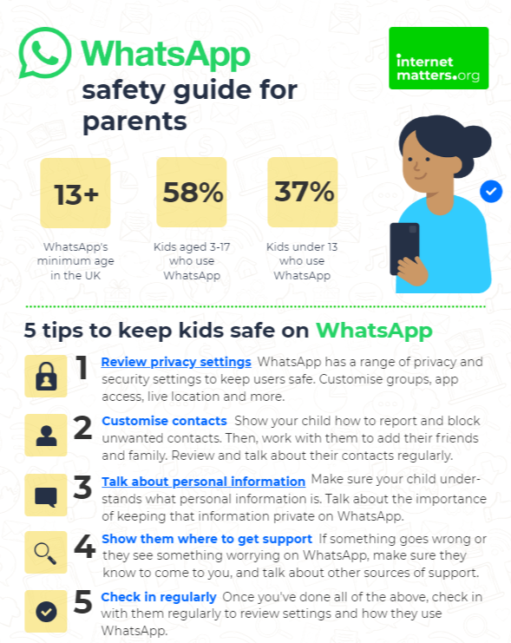
What can you do?
Visit https://www.internetmatters.org/resources/whatsapp-safety-a-how-to-guide-for-parents/#whatsapp-safety-tips for advice for parents
Notes:
SHARE – 5 top tips from the parent safety guide at https://www.internetmatters.org/resources/whatsapp-safety-a-how-to-guide-for-parents/#whatsapp-safety-tips
EXPLAIN – it’s useful to talk with children about etiquette when using group chats e.g.
how to communicate
what language to use/not use
recognition that others may see your messages if copied and shared
what to do if someone is unkind to them or others etc.

Slide 34
How can YOU GET INVOLVED?
ASK what type of games your child enjoys – are they age-appropriate?
PLAY games together - keep the tech in shared spaces rather than bedrooms
TALK about who they are playing with - what information are they sharing?
EXPLAIN what is/isn’t appropriate to share, e.g. personal details to identify them/location
AGREE how they will spend their money online
DISCUSS what they would do if they were bullied online, and what steps to take
DECIDE how long is appropriate to play in one session - how many sessions a day
SETUP these restrictions in parental settings with your child
Visit gaming.lgfl.net for advice and activities to keep them safe
Source: Children and parents: media use and attitudes report 2024

Slide 35
AGE REQUIREMENTS

Slide 36
Are YOU aware of the MINIMUM AGE REQUIREMENT for social media?
More than a third (36%) say they would allow their child to have a profile on sites or apps before they had reached the minimum age.
84% of parents of 3-17s were aware of a minimum age requirement to have a profile on social media apps
BUT ONLY
32% of parents knew the
correct age requirement
(13 yrs)
Find ratings and reviews for parents on apps, games and social media at www.commonsensemedia.org
Source: Children and parents: media use and attitudes report 2024
Notes:
Only a third of parents know the correct minimum age requirement for most social media platforms. Although the majority of parents of all 3-17s (84%) are aware that there are minimum age requirements for using most social media apps or sites, only a third (32%) think, correctly, that the minimum age requirement for most social media sites and apps is 13. However, a further 31% put the minimum age at 14 or above. More than a third (36%) of parents of all 3-17s say they would allow their child to have a profile on sites or apps before they had reached the minimum age required. While this is unchanged at an overall level since 2022, there has been an increase in the proportion of parents of all 5-7s who say they would do this (30% vs 25% in 2022).

Slide 37
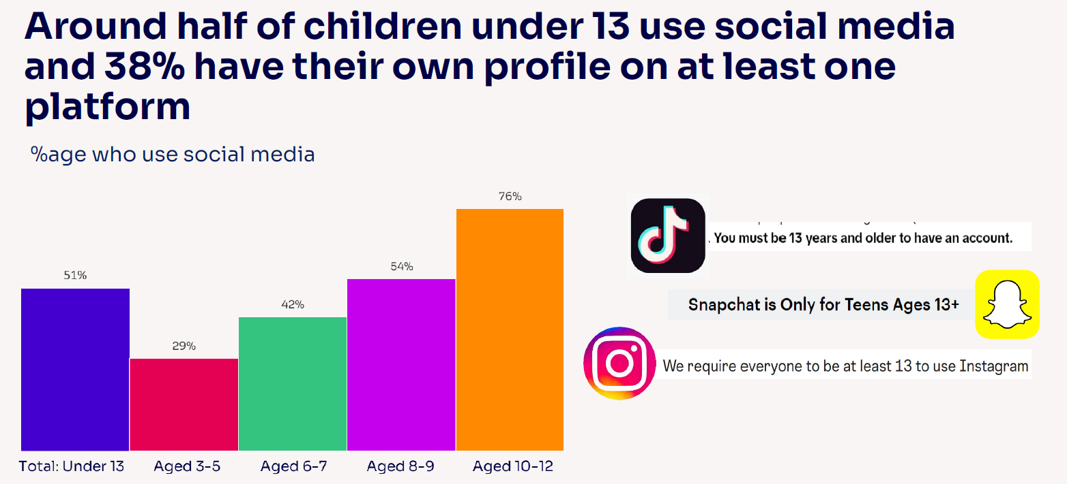
Given the 13+ minimum age requirement on most of these social media platforms, it is notable that half (51%) of children under 13 use them.
Source: Children and parents: media use and attitudes report 2024

Slide 38
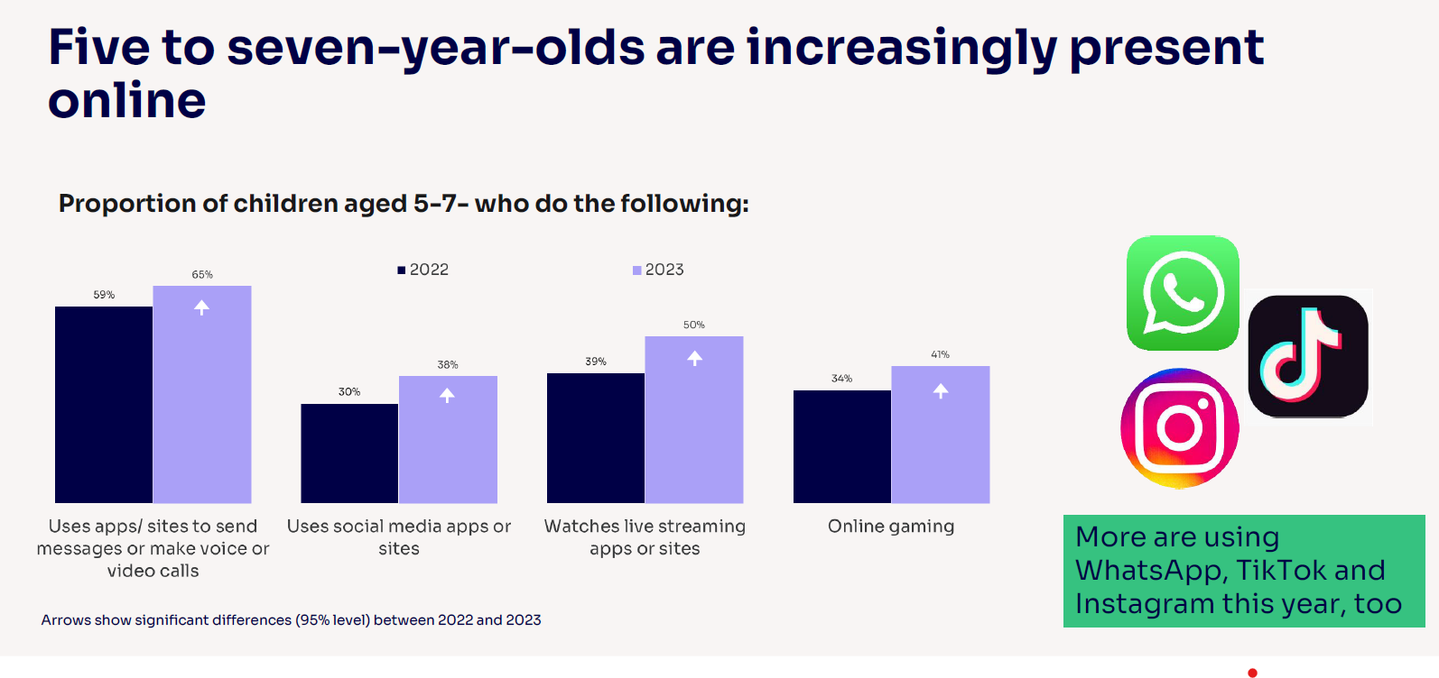
Notes:
Five-to-seven-year-olds are becoming increasingly present online, which may pose greater risks for them: Compared to last year, a higher proportion of all 5-7s use apps/sites to do each of these activities:
send messages or make voice/video calls (from 59% to 65%)
use social media apps or sites (from 30% to 38%)
watch livestreaming apps or sites (39% to 50%)
game online (34% to 41%).
Children this age are also more likely to use WhatsApp (37% vs 29%), TikTok (30% vs 25%), Instagram (22% vs 14%) and Discord (4% vs. 2%) compared to last year.

Slide 39
RISKS AND NEGATIVE EXPERIENCES

Slide 40
So what are the RISKS?
content: being exposed to illegal, inappropriate, or harmful content, for example: pornography, fake news, racism, misogyny, self-harm, suicide, anti-Semitism, radicalisation, and extremism.
contact: being subjected to harmful online interaction with other users; for example: peer to peer pressure, commercial advertising and adults posing as children or young adults with the intention to groom or exploit them for sexual, criminal, financial or other purposes
conduct: online behaviour that increases the likelihood of, or causes, harm; sharing and receiving explicit images (e.g. nudes and semi-nudes and/or pornography and online bullying
commerce: risks such as online gambling, inappropriate advertising, phishing and or financial scams
Keeping Children Safe in Education
Notes:
TELL - The 4 Cs of online safety is a useful way to identify online safety risks for children (content, contact, conduct and commerce)
We will now take a look at some of these in more detail over the next few slides

Slide 41
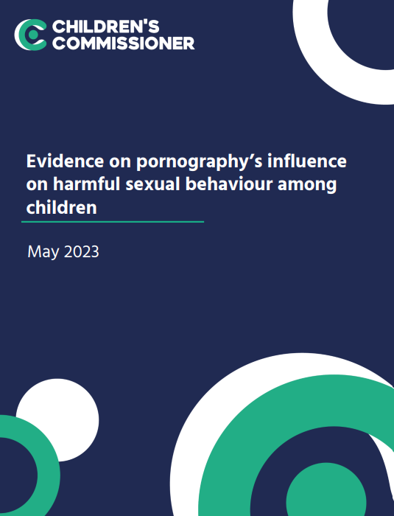
Average age children first view pornography is 13
Substantial proportions viewed it at a much younger age– 27% by age 11 and 10% by the age of 9
Unbearable pressure to view hardcore pornography even if they do not want to
Degrading acts and violence against women
Think it is reflective of real life or healthy relationships
Pornography sites are not the only way, or even the most popular way, that young people access online porn
Wide prevalence of on social media platforms such as Twitter, Snapchat and Instagram
Source: https://www.childrenscommissioner.gov.uk/resource/pornography-and-harmful-sexual-behaviour/

Slide 42
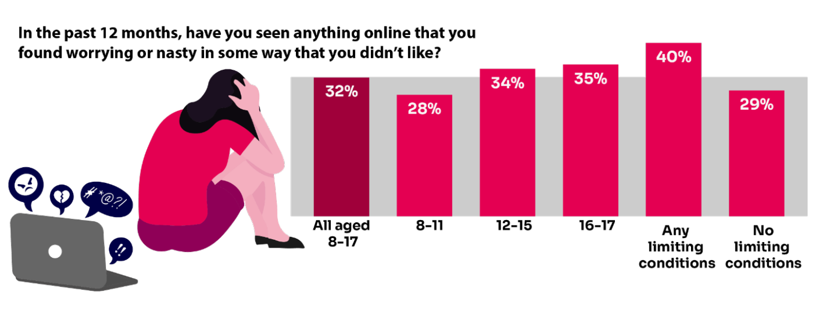
Summary of children’s negative experiences:
BUT Only 20% of parents report their child telling them about this in the same time frame.
Source: Children and parents: Media use and attitudes report 2023
Notes:
TELL:
A third of 8-17-year-old children are being exposed to content online that they find worrying or nasty, but only 20% of parents report their child telling them they had seen something online that scared or upset them in the same time frame.
The likelihood of children seeing this type of content increases with age - just over a third of 12-17s say they have been exposed to this type of content in the past year (34%) compared to 28% of 8-11-year-olds.

Slide 43
Bullying
Increase in the proportion who have experienced bullying via social media apps/sites (18% vs 15% in 2022)
girls are more likely than boys
Source: Children and parents: Media use and attitudes report 2023
Notes:
Three in ten of all 8-17s (31%) have experienced bullying via communications technology, compared to less than two in ten (18%) who have experienced it face-to-face. These two experiences are not necessarily mutually exclusive, and some bullying may be carried over between the online and offline worlds. While we have not seen any movement in these overall proportions since last year, we have noticed an increase in the proportion of all 8-17s who have experienced bullying via social media apps/sites (18% vs 15% in 2022).

Slide 44
Nudes / Semi-Nudes
Older girls (aged 16-18) were more likely than boys to have ever been exposed to potentially uncomfortable or unwanted types of contact:
Asked to share naked/half-dressed pictures of themselves 24% (2023) vs 9% (2022)
Receiving pictures or videos of naked / half-dressed people
32% (2023) vs 11% (2022)
Source: Children and parents: Media use and attitudes report 2023
Notes:
The Online communication among children quantitative research study found that older girls (aged 16-18) were more likely than boys of the same age to have ever been exposed to all ten of the potentially uncomfortable or unwanted types of contact about which they were asked. These include receiving pictures or videos of naked/half-dressed people (32% vs 11%) and being asked to share naked/half-dressed pictures of themselves (24% vs 9%).

Slide 45
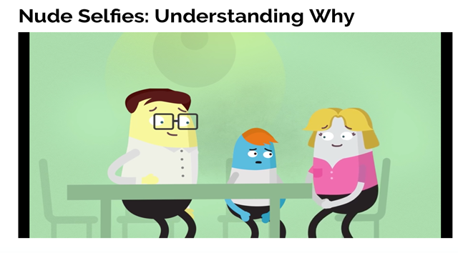
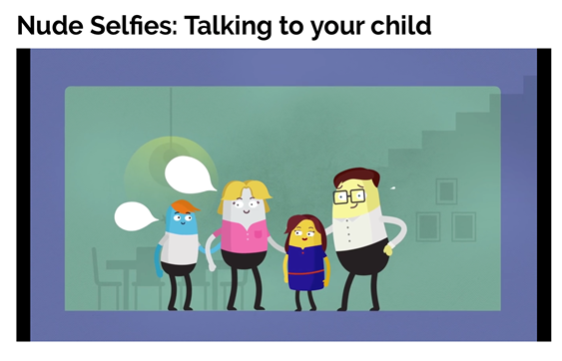
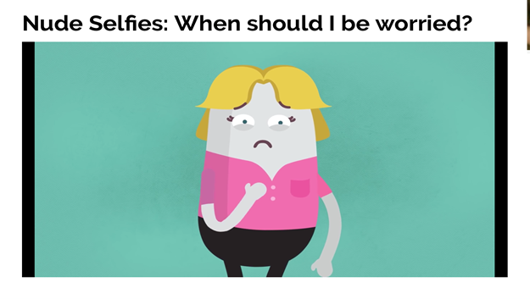
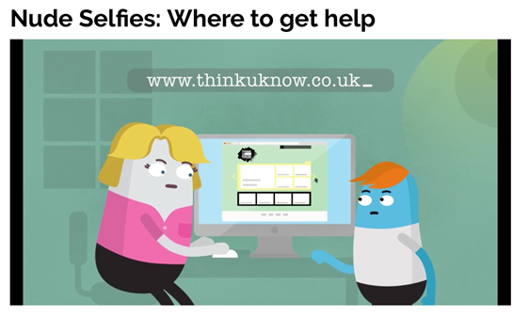
So, what can YOU do?
youtu.be/XjV0lKYpakk?si=6ONdtZJRjfB6bSRj – what parents and carers need to know
youtu.be/E5LA2nKHVZ0?si=gU3_jXFF51TU3vTq – when should you be worried?
CEOP
Notes:
SHARE – play relevant video to encourage discussion:
youtu.be/XjV0lKYpakk?si=6ONdtZJRjfB6bSRj – what parents/carers need to know
youtu.be/E5LA2nKHVZ0?si=gU3_jXFF51TU3vTq – when should you be worried

Slide 46
UK Reporting Helplines and Services for Children and Young People
NCA
Young people can report concerns about child sexual abuse and exploitation to NCA
Report Remove
A free tool that allows children to report nude or sexual images and videos of themselves that they think might have been shared online
ChildLine
A free, private and confidential service where CYP can talk about anything to a trained counsellor, online or on the phone
Call 101 or 999 if there is an immediate risk of harm to your child
Go to reporting.lgfl.net to find out more
Notes:
TELL – Talk to your children about these free reporting helplines to support them if they are worried.
For older children, The Mix provides help for young people aged 11-25

Slide 47
So, what can YOU do?
undressed.lgfl.net
Notes:
TELL - LGfL have created this series of resources which are appropriate for very young children, the dangers of taking your clothes off if you are using a device.
PLAY – Undressed video: https://undressed.lgfl.net/

Slide 48
STAYING SAFE ONLINE AND REPORTING

Slide 49
What do YOUNG PEOPLE do to STAY SAFE ONLINE?
Only 17% had used a reporting or flagging function
(36% were aware of these functions)
Go to reporting.lgfl.net to find out how to remove content from social media and where to report bullying, racial hatred, terrorism, sexual abuse and more
Source: Children and parents: media use and attitudes report 2024
Notes:
TELL - It is positive that children generally know about safety measures, but there seems to be a gap in their knowledge about reporting and putting the knowledge into practice.

Slide 50
Remember!
Before signing up to any app/site, check that your child meets the minimum age requirement for the platform to understand the risks
Remind your child to be cautious about accepting friend requests - a real friend is someone they/you know in real life, not a ‘friend’ they met gaming or in a chat room. Encourage them to ask you for advice if they are unsure.
Stress the importance of not sharing personal information with online ‘friends’
Keep passwords confidential
Check their privacy settings, emphasising the importance of not sharing personal information with strangers, and emphasising the confidentiality of passwords are all important steps
You can report any content, e.g. a post, image or harmful, misleading or damaging comment
Remember that reporting doesn't guarantee immediate removal, as platforms assess reported content based on their respective rules and policies

Slide 51
UK Reporting Helplines and Services for Children and Young People
NCA
Young people can report concerns about child sexual abuse and exploitation to NCA
Report Remove
A free tool that allows children to report nude or sexual images and videos of themselves that they think might have been shared online
ChildLine
A free, private and confidential service where CYP can talk about anything to a trained counsellor, online or on the phone
Call 101 or 999 if there is an immediate risk of harm to your child
Go to reporting.lgfl.net to find out more
Notes:
TELL – Talk to your children about these free reporting helplines to support them if they are worried.
For older children, The Mix provides help for young people aged 11-25

