Slide 1
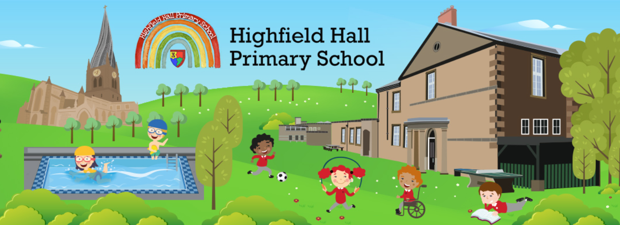
Highfield Hall Parents’ Welcome Meeting 2023

Slide 4
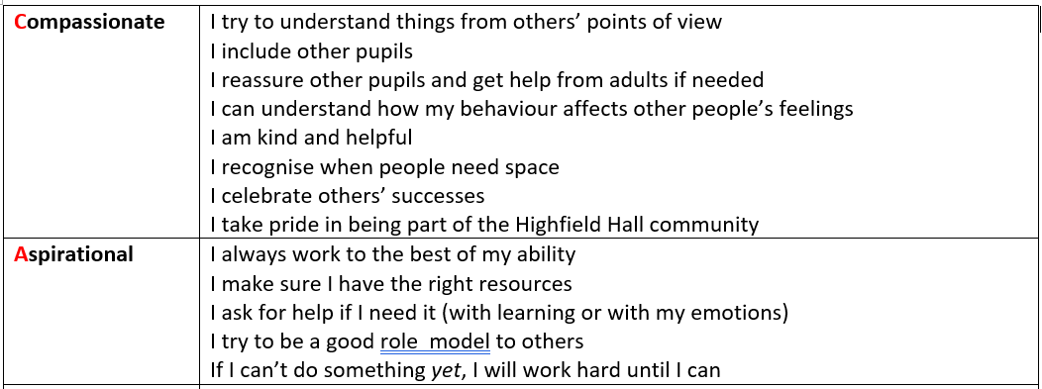
CARE

Slide 5
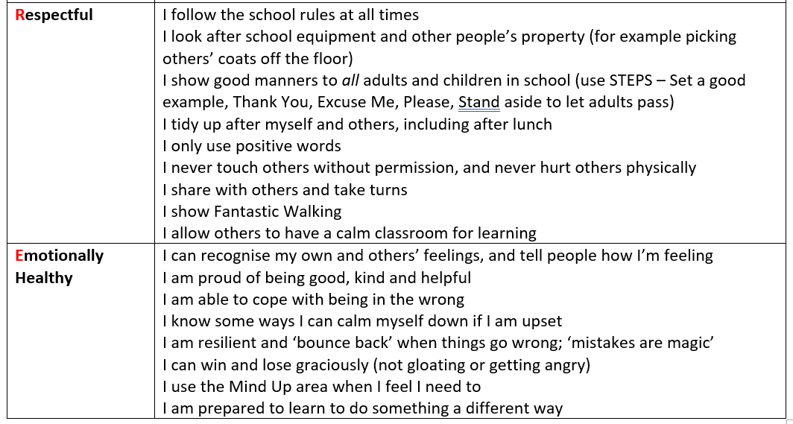
CARE

Slide 6
Behaviour
We have tried to be as explicit as possible about behaviour expectations at school.
The children should know what is expected of them (for example they might come home talking about ‘fantastic walking’).
There are lots of rewards on offer for good behaviour, e.g.:
A smile or praise
House points
Green cards
Hot chocolate Friday (or ice cream) with Dr Bywaters
CARE values certificate in assembly
Each class has a marble jar in which the children will work towards an end of term prize.
After the October half term Miss Abbott’s class will have a secret student prize

Slide 7
Behaviour
Where children have not met the expectations, in most circumstances they will be give reminders before any consequence is put in place.
However with some behaviour (e.g. physical aggression towards others), a consequence may happen straight away as the children have a right to be safe in school.
If your child does receive a white or yellow card, and you’re not sure about why it was given, please come and talk to us.

Slide 8
Uniform
The uniform at Highfield Hall is:
- Plain dark trousers, leggings or skirt (grey or black)
- White shirt or polo shirt
- Red cardigan or jumper
- Black shoes
PE Kit:
- Plain dark tracksuit or shorts (black or dark blue)
- White t-shirt
- Dark trainers
Children should wear their PE kit to school on PE days.
This is a Thursday for both classes.
However, Miss Abbott’s class will be having cricket sessions on a Wednesday until the October Half term.

Slide 9
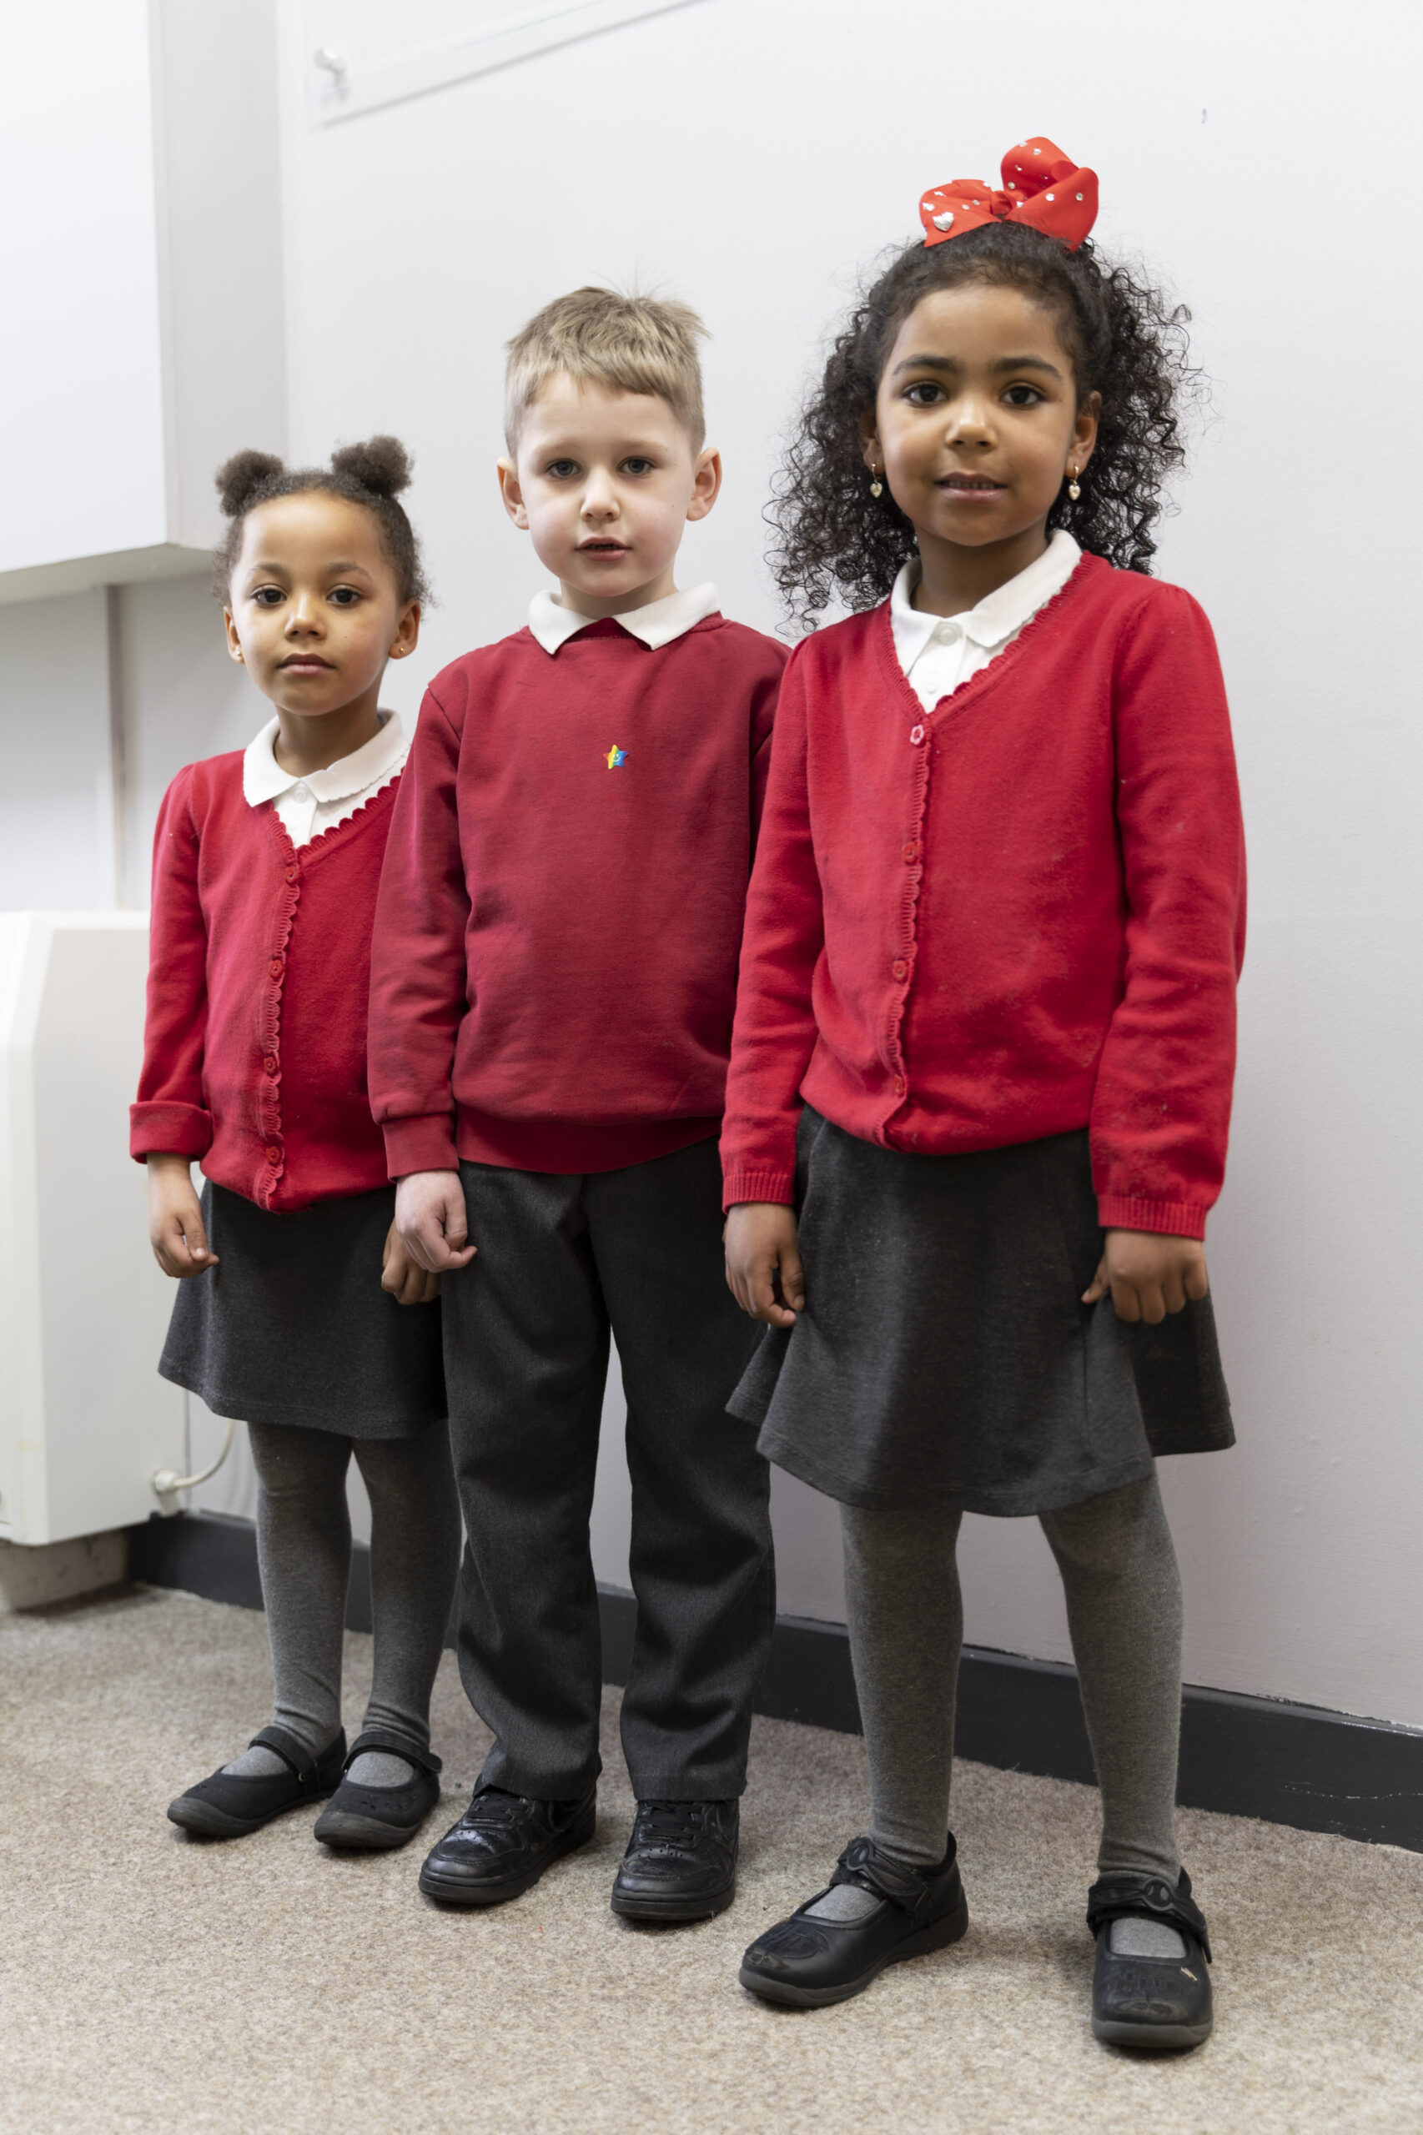
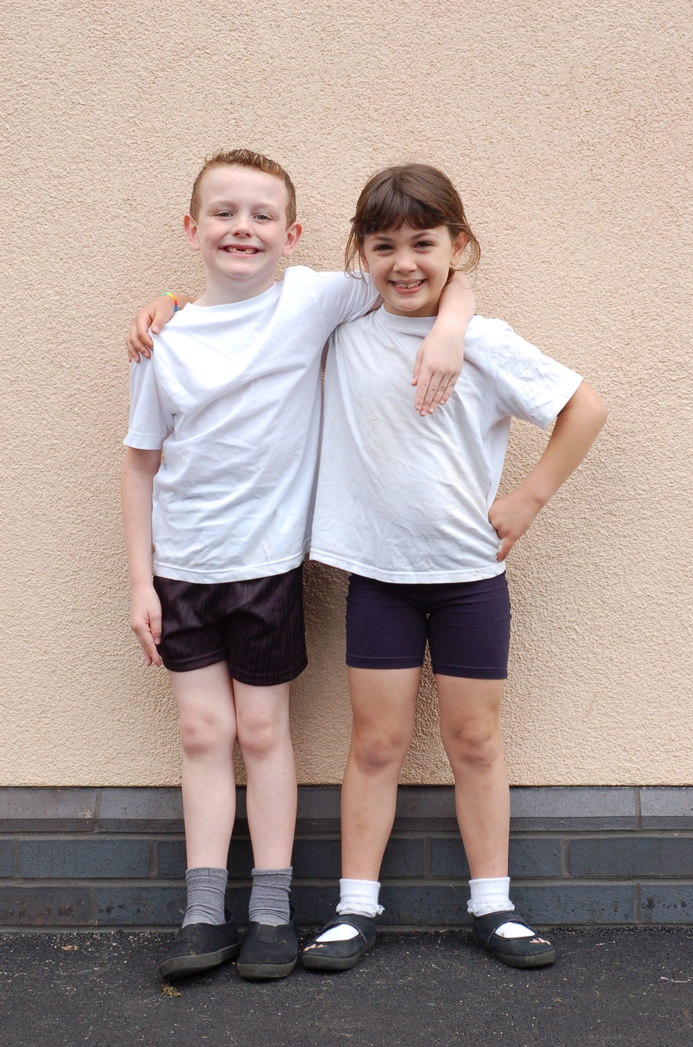
Uniform
There is a link on the website to the Highfield Hall School Shop where you can purchase uniform. You can also purchase uniform (e.g. polo shirts, red school jumpers) from high street shops; there is no need for the uniform to carry the school's logo.

Slide 10
At Highfield Hall we:
care for children and support each child to reach their potential
ensure that all children are safe, including when necessary referring any concerns to outside professional
treat all children with equity (not treating all children the same, but ensuring fairness)
give parents the opportunity to be involved in the life of the school and an active partner in their child’s education
provide work which meets the needs of the children
keep parents informed about progress, success and any concerns we may have through parents’ evening, reports and additional meetings as necessary
ensure that children are polite and well mannered
help children develop a sense of responsibility and to care about others
treat parents and children with respect
be a good role model for children
give parents timely information about upcoming events
be clear in our expectations of the children (in an age-appropriate way)

Slide 11
We ask our parents to:
ensure that their child is in school on time, in school each day (unless poorly), and collected on time
know that staff in school care about your children and are on your side
not believe everything your child tells you about school (and check with school staff before believing the worst), and support us in our rules / decisions
understand what appropriate reasons for absence are, and inform us as soon as possible about any absences
support their child with reading and homework
treat school staff and each other with respect
Expect their child to become independent and responsible
Expect their child to treat others with respect and consideration at all times
encourage resilience and perseverance, particularly with things children say then don’t want to do / support school even when children don’t want to do something (e.g. swimming, PE)
Trust staff to deal with behaviour issues fairly – if a sanction has been given the incident will either have been witnessed by an adult, or given following an investigation and having spoken to all those involved.

Slide 12
Communication
Communication is critical, and we want to have good, two-way communication with you.
Sometimes this can be difficult if we are getting ready to start the day. If there are small bits of information to hand over, please do this when the children are lining up at the start of the day.
If you need a longer conversation, please phone the office to organise some dedicated time or ask for a phone call.
You can email info@highfieldhall.derbyshire.sch.uk and they will forward the email to the best person to deal with the message. We will reply as soon as possible, and certainly within 3 working days.

Slide 13
Communication
The dates card for the year will be sent out very soon.
In addition, each week, we will send out an App message containing:
Reading expectations and the days reading records should be brought in
Any key word spellings / home work instructions
Any forthcoming dates / events
Which group is swimming (although this will now be the same every week for a while)
Any other reminders (e.g. uniform expectations)

Slide 14
Communication
We know the website is hard to navigate; we are finalising a new website which should be much more user friendly. This should be ‘live’ this month.
There will also be a new App – please look out for information about this and download it as this is our main communication method.

Slide 15
Homework
Reading | 10 minutes, three times a week at least. This should be out loud to an adult. All children should bring their reading records in every day. On a Thursday house points will be awarded in relation to the number of reads signed by a parent.
Times Tables (This will be updated after October half term) | We would encourage children to use the Garage game on Times Table Rock Stars at least three times a week as part of their times tables homework. They have their logins in the front of their reading records. Times tables practice is a vitally important element to a large range of Maths units in school. The children will be taking a government-set test on times tables in June 2023.
Spellings Spelling shed homework optional. | There is a spelling test each week. This will be on a Thursday for Miss Gleadall’s class and Fridays for Miss Abbott’s class. The children's new spelling list will be added to the page each week on a Friday. (Miss Abbott’s class Optional) The children will also be able to access these spellings at home via Spelling Shed. This will enable them to access a platform that has games specifically linked to this weeks spellings. The children's login can be found at the front of their reading record.
Topic | The children may occasionally bring home topic based homework. (This may include science).

Slide 16
Times Tables
As you may be aware at the end of Year 4 the children will be accessing a statutory Times Table assessment.
This means there will be a number of things in place throughout the year to prepare the children as much as possible.
Next week the children will be taking part in a national Times Table competition, the children will receive a log in for this and will be encouraged to access this both at home and in school time.
Each fortnight the children will bring home an up-to-date heat map. This will help to understand which times table facts your children need to practice a little more.
Children will also have targeted times table facts to learn each week. These will be in sets of three and will be in relation to your child’s heat map. These will be tested and updated weekly. The children will bring these home but need to ensure they’re in school each day.

Slide 17
Curriculum

Slide 18
Curriculum

Slide 19
The year group page.
This year you will notice that each year group has a shared page. This page will be updated with all the year groups information.
https://www.highfieldhall.derbyshire.sch.uk/year-4-6/

